Slide 1
Terminology of Journalism
Higher National School of Journalism & Information Sciences
Dr. Narimen HAMDINI

Slide 2
Warm UP!
Guess the word if you can!
The face of a TV Show ………..
Could be any shape, used to present thoughts and words especially in caricature …………
Make reader fall in love from the first sight ………..
A tiny place on the top corner can be how is the weather ……..
A full name above or bellow a text………;
A special story to lead to cover page usually used to attract attention ……..
I wonder how many pages are they ??! ……
You can’t exceed the lines …………
MBC1, as well as MBC2, MBC3, MBC4, MBC5, MBC MASR, MBC IRAQ , all are …………

Slide 3
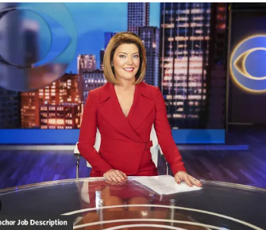
Terminology
An anchor is the face of the program. They are professials who present live news to the audience through a live broadcast

Slide 4
Terminology
Balloon A drawing, usually in a comic strip, which makes the words of a person in the picture appear to be coming directly from his mouth

Slide 5
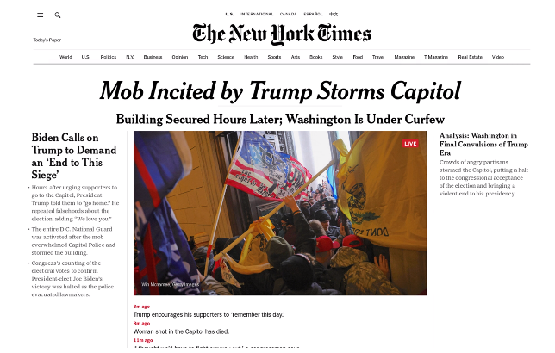
Terminology
Banner A headline in large letters running across the
entire width of the first page.

Slide 6
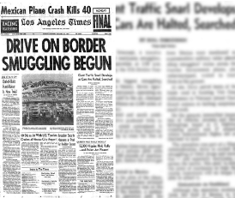
Terminology
Box: Border around a story or photo.

Slide 7
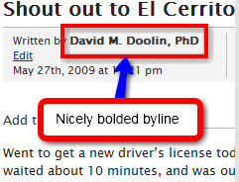
Terminology
Byline The name of the writer printed at the top of a story.

Slide 8
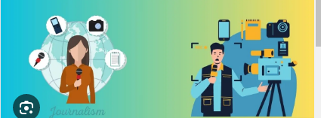
Terminology
To Cover :To gather information and get facts for a story.

Slide 9
Terminology
Feature A story in which the interest lies in some factor other than the news value, usually to entertain

Slide 10
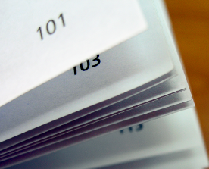
Terminology
Folio :The number (s) of the page.

Slide 11
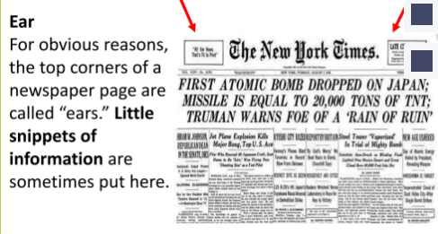
Terminology
Ear Either corner at the top of the front page (sometimes
used for weather news or to call attention to a special feature).

Slide 12
Terminology
Media-outlet : A publication or broadcast program that
provides news and feature stories to the public through
various distribution channels.
Media coverage refers to the attention and exposure
received by a person, brand, event, or topic in various forms
of media, including print, broadcast, and digital platforms.

Slide 13
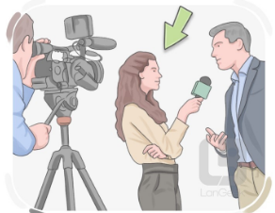
Terminology
Correspondent: one who contributes news or commentary to a publication (such as a newspaper) or a radio or
television network often from a distant place.

Slide 14
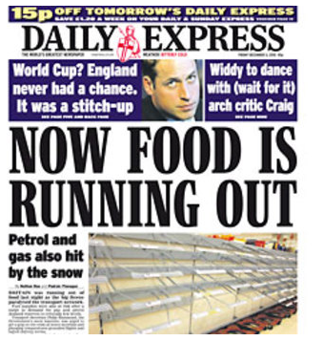
Terminology
Sensationalism: the act by newspapers, television, etc. of presenting information in a way that is shocking or
exciting: The newspaper has been accused of sensationalism

Slide 15
Terminology
Journalist a person who writes news stories or articles for a newspaper or magazine or broadcasts them on radio or television
Affiliate
A station associated with a network by contract to broadcastthe network's programs.

Slide 16
Terminology

Slide 17
Terminology
Manipulation tactics can include cloaking one's identity or the source of the artifact, editing to conceal or change the meaning or context of an artifact
Politicians are individuals who hold or seek positions of
authority and governance within a political system, often
making decisions that affect public policy

Slide 18
Terminology
Celebrities are individuals who have gained fame and public recognition, often due to their work in entertainment, sports, or social media
Tabloid : a newspaper that is about half the page size of an ordinary newspaper and that contains news in condensed
form and much photographic matter type of popular, largely sensationalistic journalism that takes its name from the
format of a small newspaper,

Slide 19
Terminology

Slide 20
Lets 'Practice
Anchors, outlets, coverage, correspondents, sensationalism, journalists, affiliate, manipulate, politicians, celebrities, tabloids, networks
The BBC is one of the most well - known new........... in the world . They are based
in the UK , but they have ......... in almost every country in the world . On their
international news network, BBC World , they give ……… to events all over the
world . The …….. are very professional - looking and they read the news clearly
and with a very serious attitude . Last year , their business ……….. John Johnson
won the award for Best International Business Reporting .......... However , there
are also many , less serious , media ……. in the UK . Every day , many people
read ……. , which contain stories about the personal lives of ............. and..........
Many people dislike these tabloids , because they say that the ……… write stories
that are not true and ........ stories to try to make them more interesting .
Because of this , many people protested outside the offices of one of the
country's biggest tabloids , saying , ? This is not news . It is …………

Slide 21
THANK YOU

