Slide 1
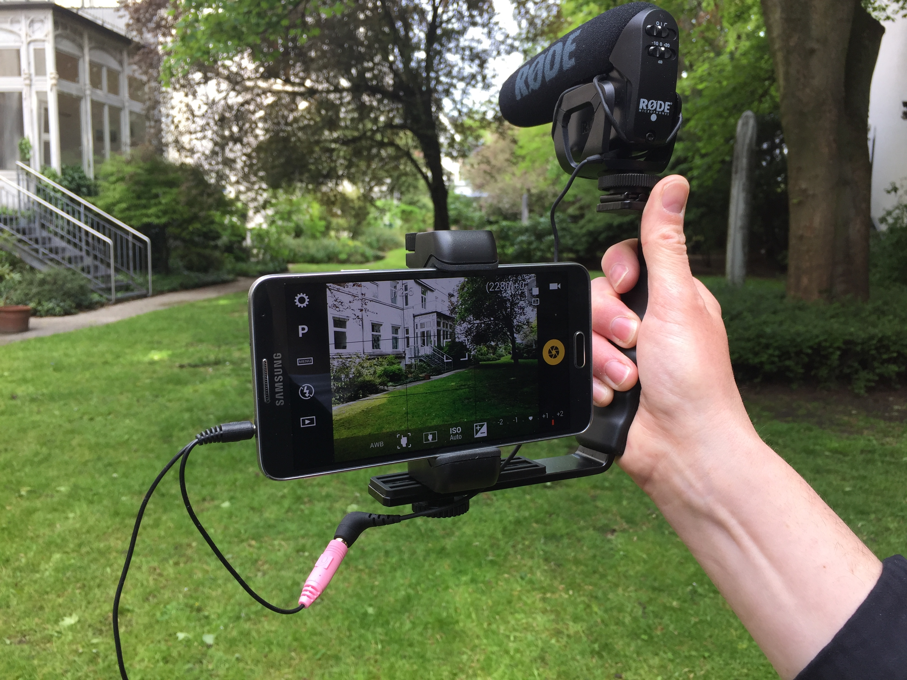
Mobile Journalism
The Newsroom from your pocket

Slide 2
Summary
Context
What is it?
How does it work?
Is it useful?
Tips
Practical task
Feedback

Slide 3
Context
“mobile telephony has moved from being the technology for a privileged few, to essentially a mainstream technology” (Castells, Fernandez-Ardevol, Qiu, & Sey, 2004, p. 5).
Television viewing figures in the UK and the US have declined by 3 to 4% a year on average since 2012
The Digital News Report 2015 found that 46 per cent of people in all twelve countries surveyed now access news weekly on their smartphones

Slide 4
What is it MOJO?
“radical personalisation of news-gathering” (Goggin, 2006, p. 147).
journalistic practice based on reporters with portable multimedia newsgathering equipment (Ivo, Quinn, 2016)
A new form of storytelling

Slide 5
Why?
The amount of videos from smartphones on national bulletins is increasing
Financial climate

Slide 6
Citizen journalism
Committing a random act of journalism (Lasica, 2003)
When the people formerly known as the audience employ the press tools they have in their possession to inform one another (Rosen, 2008)
Act of citizens or group of citizens involved in the process of collecting, reporting, analysing and disseminating news and other formats of information (Bowman, Willis, 2003)

Slide 7
MoJO or Citizen journalism?
http://nickgarnett.co.uk/project/mojohistory/
http://www.intelligencesquared.com/events/smartphone-journalism-the-changing-face-of-news/

Slide 8
Types of MOJO?
User Generated Content
Citizen journalism
Professional journalists

Slide 9
So…how does this change journalistic practice?
The way we consume news
The way the content is produced

Slide 10
But…
MoJo seemed to be the next big thing but broadcasters rarely use this type of content
A fantastic step forward but only a means of recording, editing and transmitting material
The practice of “mobile reporting” is still in its infancy

Slide 11
Any risks?
No internet
Reporting from rural areas
No technological skills
Digital divide

Slide 12
Tips
Clean your lens
Switch your phone to airplane mode
Check settings/ reduce resolution
Don’t hold the camera vertically. Record only horizontally
Adjust focus and exposure
Never zoom in
Stay still
Don’t talk directly into the microphone

Slide 13
Let’s look at some examples
http://nickgarnett.co.uk
http://www.bbc.co.uk/academy/journalism/skills/filming-and-recording/article/art20130702112133395
http://www.bbc.co.uk/academy/journalism/article/art20130702112133386

Slide 14
Practical task
Work in groups to create your mobile story. Please use the hand-outs.

Slide 15
Further reading
Bradshaw Paul, Rohumaa Liisa. 2013. The Online Journalism Handbook: Skills to survive and thrive in the digital age. London & NY: Routledge.
Burum Ivo, Quinn Stephen. 2016. MOJO: The Mobile Journalism Handbook- How to make broadcast videos with an iPhone or iPad. Ny& London: Focal Press.

